Slide 1
Lecture 10 – System Safety
Notes:
A systems level view of safety is one of the most important roles for a systems engineer on a project. Accidents in large high technology endeavors are rarely due to a failure of a single component or lack of engineering of a single component. Vulnerable systems due to single failure or weaknesses usually never make it out of the testing stage. System tests are usually conducted with awareness of the new nature of systems and the potential for catastrophe is usually mitigated, It is only systems deployed into operations that have the potential for huge damage, To fail, these systems usually require multiple interacting failures or off-nominal conditions. The detection of the susceptibility of systems to catastrophic failure due to multiple interacting failures or off-nominal conditions is the purpose for the system safety techniques identified ion this lecture. Although this techniques rely heavily on the imagination and creativity of the people conducting the analysis, they are amazingly effective because they work at exposing blind spots in system design.

Slide 2
System Safety
Safety Hierarchy
Systems Hazard Analysis
Fault Tree Analysis
FMECA
Probabilistic Risk Analysis (PRA)

Slide 3
Safety Hierarchy
Clearly establishes priorities within an organization
Example - At NASA the safety hierarchy is
  Safety of the general public
  Safety of our flight crews
  Safety of all other NASA personnel
  Safety to mission critical or high value hardware
So for example, per this hierarchy, we will
  risk a crew to prevent injury to the public (this is why we fly a range safety destruct system on shuttle)
  we will also expend hardware to save flight or ground personnel (why we fly ejection seats on most research aircraft)

Slide 4
Hazard Analysis
A structured thinking process to
  Identify risks
  Categorize risks
  Determine and implement mitigations
Attempt to identify potential causes of loss of crew and vehicle by a “what-if” process
Best done during the design process
  Usually most effective to design a hazard out of a system
  Evaluation must be performed early to implement mitigations in design
Must be re-evaluated as flight experience is gained
  At time of Columbia accident, shuttle hazard analyses had not been reviewed since mid 80’s despite documented plans to review every 3 years
A fault tree is an effective mechanism for communicating and searching for potential hazards in a structured way

Slide 5
Essential Elements of Hazard Analysis
Categorizing each potential negative outcome by Likelihood and Severity
Standard processes at NASA use a 4 by 3 (likelihood vs consequence) or a 5 by 5 array
In a 4 by 3 system
  Likelihood is rated from
    Improbable – never will happen in the life of a program
    Remote – could happen in the life of the program
    Infrequent – could happen multiple times in the life of a program
    Probable – likely to happen
  Severity is rated from
    Marginal – limited damage or minor injury to personnel
    Critical – major damage to vehicle, facilities or major injury to personnel
    Catastrophic – Loss of personnel or vehicle

Slide 6
Each Combination of Likelihood and consequence is rated
Hazard causes that are catastrophic and Probable are rated RED
  Traditionally these are considered “showstoppers”, i.e. cannot proceed unless these risks are mitigated
Hazard causes that are Probable and Infrequent but not catastrophic are rated YELLOW
  They are likely but of limited effect
  YELLOW risks require mitigation
Hazard causes that are Infrequent or Remote but are catastrophic are rated YELLOW
  They are not likely but are so serious that they require additional mitigation
  YELLOW risk require mitigation
Other hazard causes are rated GREEN – accepted risks without further mitigation
  They are unlikely or of limited severity

Slide 7
Hazard Analysis Matrix
Severity
 | Marginal | Critical | Catastrophic
Probable
Infrequent
Remote
Improbable
Likelihood
Red-unacceptable
Yellow – accepted risk
Green - controlled
Notes:
Here is an example hazard analysis matrix.
Probable-Catastrophic hazards are RED and are unacceptable.
Improbable events are GREEN and are acceptable without mitigation.
Remote Events with Marginal Severity are GREEN and acceptable without mitigation.
All other combinations of severity and likelihood are YELLOW and require mitigation, i.e. something which reduces either the likelihood or severity.
Typically as hazards are identified they are given numeric identifiers and the identifiers are placed on the matrix so risk posture can be communicated in a glance.
Although a simple technique, it is powerful because it structures your thinking and allows you to compare risks. This is particularly important when resources are limited and you have to place your resources on mitigating the most critical hazards.

Slide 8
Each hazard that requires mitigation
For each hazard cause that requires mitigation we establish a
  CONTROL – an activity which prevents the hazard from occurring
  VERIFICATION – the activity which shows that the control is in place

Slide 9
Example – Hazard Analysis for Commuting from Home to School and back
Hazard causes on a commute to and from school include
  Tire blowout is a cause for loss of control
  Engine failure is a cause for loss of control or being stranded on the road
  Collision with another vehicle is a cause for impact damage
  Collision with road debris is a cause for impact damage
  Road conditions is a cause for loss of control
  Flash flood is a cause for stranding and drowning

Slide 10
Hazard Analysis – Commute to School
Hazard Number | Hazard | Likelihood | Severity | Color | Control | Verification
1 | Tire Blowout | Infrequent | Critical-Catastrophic | Yellow | Proper tire inflation and tread wear. Carry spare. | Inspect on a regular basis and check inflation. Ensure proper spare storage
2 | Engine Failure | Infrequent | Critical | Yellow | Regular maintenance checks | Maintain vehicle log and perform scheduled checks per log
3 | Collision with another vehicle | Remote | Catastrophic | Yellow | Operator awareness. Increase Vehicle visibility by lights on. Wear seat belt. | Operator Training and pre-launch procedure
4 | Collision with road debris | Infrequent | Critical-catastrophic | Yellow | Operator awareness. Reduce speed in low visibility conditions. | Operator training
5 | Road conditions | Infrequent | Critical-catastrophic | Yellow | Operator awareness. Listen to alerts on radio. | Operator training. Pre-launch procedure
6 | Flash flood | Remote | catastrophic | Yellow | Operator awareness. Listen to alerts on radio. Route around low spots | Operator training. Pre-launch procedure

Slide 11
Hazard Analysis Matrix – Commuting
Severity
 | Marginal | Critical | Catastrophic
Probable
Infrequent |  | 2 | 1, 4,5
Remote |  |  | 3,6
Improbable
Likelihood
Notes:
Here we have placed the hazards from the commuting example on the hazard matrix.
If you had limited resources it would make sense to put them into mitigating risks, 1,2,4 and 5 as they are the closest to the RED. This is one of the best reasons for hazard analysis. It gives you a basis for prioritizing limited resources.

Slide 12
DOD MIL STD 882D
MIL-STD – 882D describes hazard analysis for Department of Defense Projects.
It is an equivalent system to NASA system, it has additional levels of severity and likelihood
It also puts a probability of occurrence number with each level of likelihood
Notes:
The Department of Defense standard is very similar to the NASA standard and is used widely throughout defense and commercial circles.

Slide 13
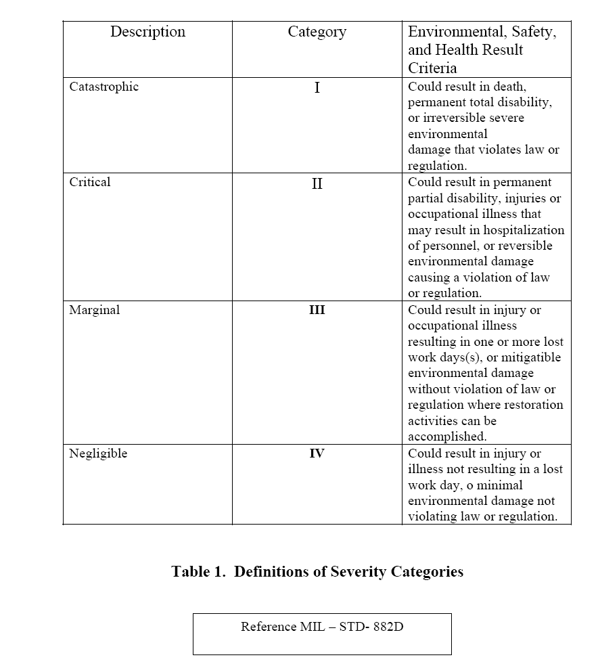
Notes:
This table lists the severity categories in the DOD system. You will note that it places loss of life or major facilities as the top severity and injury or minor damage as the least severe.

Slide 14
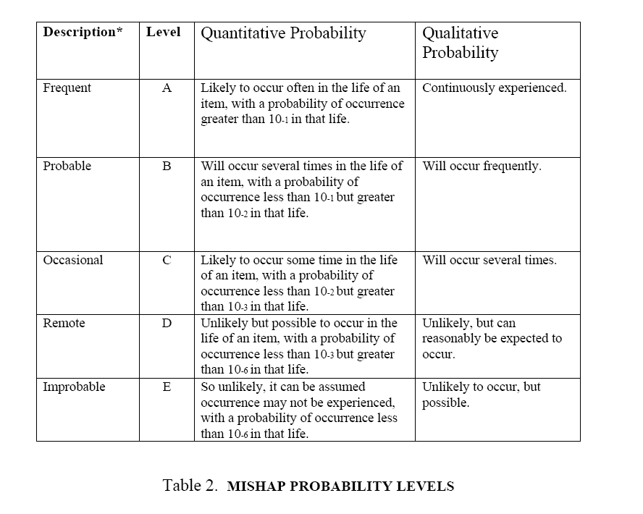
Notes:
This table lists the likelihood or probability levels in the DOD system. In the DOD system, the probability terminology includes actual probability levels.

Slide 15
Hazard Perspective
Event | Chance This Year
Car stolen | 1 in 100
House catch fire | 1 in 200
Die from Heart Disease | 1 in 280
Die of Cancer | 1 in 500
Die in Car wreck | 1 in 6,000
Die by Homicide | 1 in 10,000
Die of AIDS | 1 in 11,000
Die of Tuberculosis | 1 in 200,000
Win a state lottery | 1 in 1 million
Killed by lightning | 1 in 1.4 million
Killed by flood or tornado | 1 in 2 million
Killed in Hurricane | 1 in 6 million
Die in commercial plane crash | 1 in 1 million to 10 million (depends on airline)
http://www.cotf.edu/ete/modules/volcanoes/vrisk.html
Notes:
The purpose of the next few charts is to give some risks to compare to the risk levels identified in the DOD standard.

Slide 16
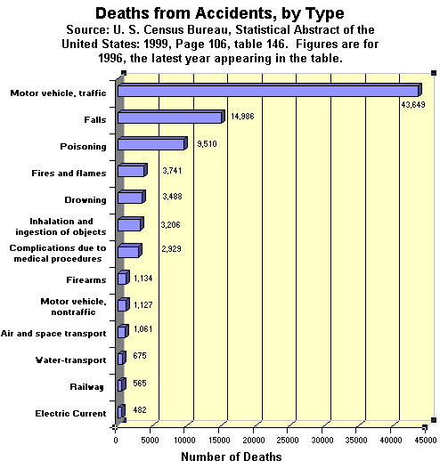
Hazard Perspective
http://www.anesi.com/accdeath.htm

Slide 17
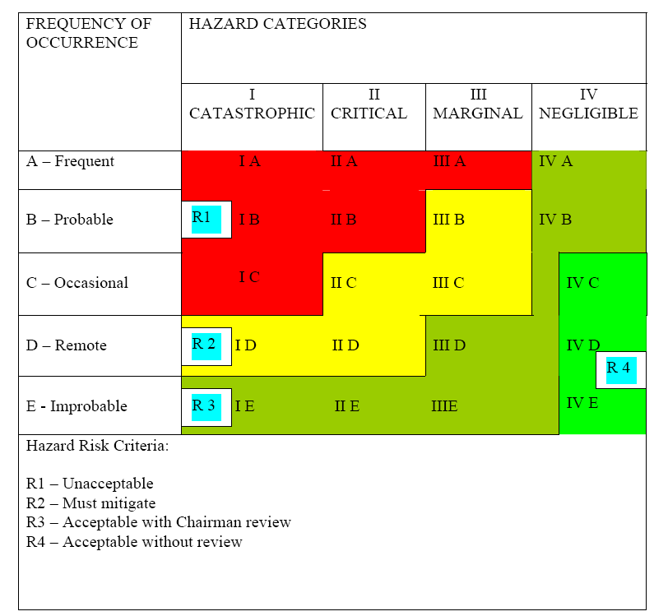
DOD 5 by 4 Risk Assessment
Notes:
The DOD 5 by 4 system gives greater resolution for risks. In this particular example, which we use at the University of Tennessee Space Institute Aviation Systems department, the different combinations of likelihood and severity require different levels of mitigation and review. The chairman in this case, refers to the chairman of the Aviation Systems Department who is ultimately responsible for the safe operations of the five specially instrumented aircraft that we operate for airborne research. He can accept certain types of risk without mitigation and is required to review mitigation plans in others. Certain types of risk cannot be waived, even by the chairman of the department.

Slide 18
Irreducible Risk
In every project, you get to a point where risks cannot be further reduced
  In our commuting example, collision with road debris is an example of irreducible risk
  You really can’t do much to eliminate the risk of road debris and there is only so much you can do to avoid it or shield yourself from it
At that point, you have to evaluate the risk and accept it if it is low enough severity and likelihood
The hazard analysis approach provides a language and technique for communicating risks

Slide 19
Risk Reduction Hierarchy of Effectiveness
In general it is preferred to
  Eliminate hazard cause by design – e.g. eliminate potential causes of fire aboard vehicle
  Eliminate hazard cause by operational procedure or workaround – e.g. don’t do things that produce sparks or open flames that could cause a fire
  Prevent operation into hazard with warning systems – e.g. install a fire/smoke detection system so that fires can be detected and extinguished
  Mitigate effect of hazard with emergency system – e.g, a system to automatically release fire fighting chemicals when a fire is detected

Slide 20
Fault Tree Analysis
Fault Tree Analysis is a technique for investigating hazards and showing how hazard causes relate to each other
Many hazards are caused by combinations of events

Slide 21
Printer Fails To Print
Paper Jam
Out of
Paper
No
Power
Printer
Data
connection
lost
Printer
driver
software
not
properly
configured
Out of
Toner
Example Fault Tree For “Printer Fails To Print”
Notes:
Here is a simple example fault tree for printing on a computer laser printer. At the bottom of the tree we have 6 independent causes. Any of these conditions can cause a printer to fail to print. The OR gate at the top says that a failure is propagated upward if any of the lower conditions are true. The causes are always at the bottom of the tree and the ultimate condition is always ta the top.

Slide 22
Gate Logic
OR Gate
 | No Fault | Fault
No Fault | Output C= No Fault | Output C = Fault
Fault | Output C= Fault | Output C= Fault
A
C
B
A
B
AND gate
 | No Fault | Fault
No Fault | Output C= No Fault | Output C = No Fault
Fault | Output C= No Fault | Output C= Fault
C
A
B
A
B
Notes:
Some of the most important symbols in fault trees are the logic gates that combine events and fault conditions in the trees. This table summarizes the logic for an “OR” Gate and for an “AND” gate. The “OR” gate outputs a “fault” condition if any of the legs leading into it are a “fault”. The “AND” gate indicates a “fault” only if all of the legs leading into it are a “fault” condition. So for example – a car won’t start if either the battery is dead or the gas tank is empty. These two faults would be combined in an “OR” gate. On the other hand if you have an alarm clock with a battery backup the only way the alarm clock can fail is if there is a fault in both the battery and the wall power so these would be combined with an “AND”.

Slide 23
Fault Tree Symbology
Transfer Gate (to other branch of tree)
Sufficient data and rationale exists to defer further tree development at this time
Bottom-level Event
Closed Event – Rationale exists to exonerate event as initiating event or contributor to event
OR Gate
AND Gate
Notes:
These are the typical symbols on a fault tree. Because these fault trees can get rather large, the transfer gate allows you to connect items on the tree where it would be cumbersome to draw lines across the entire tree. A diamond means that the tree has been evaluated and a particular leg is no longer a concern. A bottom level event means that the event is a not caused by other failures but is the root cause of a leg in the failure tree.
Starting at the bottom. The AND gate allows a fault ti propagate up the tree if

Slide 24
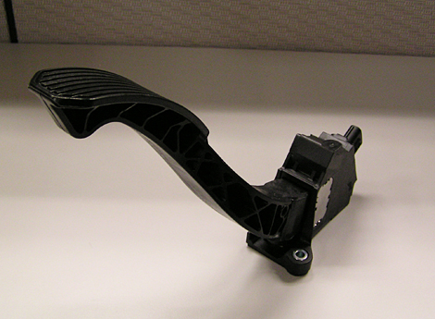
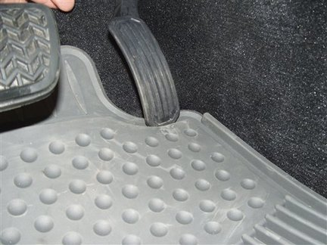
Toyota Sudden Acceleration problems
November 4 2009
NHTSA swiftly issues a statement to correct Toyota’s statement that the investigation is over:
“Toyota has announced a safety recall involving 3.8 million vehicles in which the accelerator pedal may become stuck at high vehicle speeds due to interference by the driver’s side floor mat, which is obviously a very dangerous situation. Toyota has written to vehicle owners stating that it has decided that a safety defect exists in their vehicles and asking owners to remove all floor mats while the company is developing a remedy. We believe consumers should follow Toyota’s recommendation to address the most immediate safety risk. However, removal of the mats is simply an interim measure, not a remedy of the underlying defect in the vehicles. NHTSA is discussing with Toyota what the appropriate vehicle remedy or remedies will be. This matter is not closed until Toyota has effectively addressed the vehicle defect by providing a suitable remedy.
”
then on January 22 2010
Toyota announces a new recall for sticky accelerator pedals, separate and apart from the floor mat recall. Toyota says: “Due to the manner in which the friction lever interacts with the sliding surface of the accelerator pedal inside the pedal sensor assembly, the sliding surface of the lever may become smooth during vehicle operation. In this condition, if condensation occurs on the surface, as may occur from heater operation (without A/C) when the pedal assembly is cold, the friction when the accelerator pedal is operated may increase, which may result in the accelerator pedal becoming harder to depress, slower to return, or, in the worst case, mechanically stuck in a partially depressed position. In addition, some of the affected vehicles’ pedals were manufactured with friction levers made of a different material (PA46), which may be susceptible to humidity when parked for a long period in hot temperatures. In this condition, the friction when the accelerator pedal is operated may increase, which may result in the accelerator pedal movement becoming rough or slow to return
Notes:
The problem experienced by Toyota in 2009-2010 makes a great problem to examine with a fault tree. This chart is some of the background on the problem.

Slide 25
Fault Tree For Toyota Sudden Acceleration - 2010
Pedal
jammed
under
carpet
Mechanical
failure
in
pedal
Throttle
Control
System
Failure
Operator Error
Control
Logic
Failure
Sensor
Failure
Actuator
Failure
Logic
Circuit
Failure
Software
error
Notes:
This fault tree summarizes possible causes for the Toyota sudden acceleration problem. It is interesting to note that this tree captures some of the logic that Toyota used to deal with the problem. At first Toyota blamed the sudden acceleration problem on operator error. When a sudden acceleration accident injured an experienced police officer, it became clear that the problem was not just operator error. Toyota then blamed the problem on the carpet and mats and recommended removal of the mats. When problems occurred when the mats were removed, then Toyota decided that the problem might be a mechanical problem in the pedal. This caused a huge recall. Problems have continued to happen and this has raised the suspicion that the problem might be in the electronic throttle control system. In this case the failure might be in several places. It could be in the sensor that determines the position of the pedal, or it could be the actuator that takes commands from the control system and turns it into throttle setting on the engine. It could also be caused by a control logic failure, either in hardware or software.

Slide 26
Fault tree from the Columbia accident – 13 Feb 2003
LOCV DURING ENTRY
DUE TO AERODYNAMIC
BREAKUP
LOCVAEROBKUP
AERODYNAMIC BREAKUP
AERODYNAMIC BREAKUP
DUE TO STRUCTURAL
DUE TO IMPROPER
FAILURE OF THE ORBITER
ATTITUDE / TRAJECTORY
CONTROL
GATE-2
GATE-3
LOSS OF AERODYNAMIC
STRUCTURAL FAILURE OF
AERODYNAMIC BREAKUP
AERODYNAMIC BREAKUP
CHARACTERISTICS DUE TO
ORBITER DUE TO LOSS OF
DUE TO ATTITUDE /
DUE TO ATTITUDE /
LOSS OF OML
STRUCTURAL MEMBERS
TRAJECTORY CONTROL
TRAJECTORY CONTROL
COMMAND FAILURE
EQUIPMENT FAILURE
1
4
5
6
A
C
D
E
Notes:
This is the top level fault tree that was put together a week after the loss of the Space Shuttle Columbia. The top level element was loss of vehicle and crew. This was broken into two possible causes. The left branch covered aerodynamic breakup of the vehicle because of a failure in the structure of the vehicle. The rightmost branch described the possibility of breakup caused by a loss of control of the vehicle.
The left most branch turned out to be the proximal cause of the accident. In particular structural breakup was considered to be potentially caused by one of two faults. The first fault identified was that somehow the outer mold line (OML) or the outer shape of the shuttle orbiter was altered which would cause extreme heating of the vehicle. The second fault identified was the possibility of a failure in the underlying structure which would lead to collapse of the vehicle.
It turned out that a 1.67 lb piece of foam from the External Tank had broken away during launch and had impacted the wing causing a breach in the wing that lead to excessive heating that led to failure of the wing.

Slide 27
Failure Modes Effects Criticality Analysis (FMECA)
Hazard Analysis is a top-down process
  Start with a top level event and try to determine the possible causes
FMECA is a bottoms up process
  Start with every component and analyze how it can fail and the potential effects of that failure on the system
Hazard Analysis can be performed at the start of system design and updated as the design progresses
FMECA requires design to be in sufficient detail to allow identification of credible failure modes
Failure Mode is identified, and then criticality of failure to total system operation is identified
  Criticality Level Effect of Failure
    Crit 1 Loss of Life or Vehicle
    Crit 1R Failure of all redundant hardware items could cause loss of life or vehicle
    Crit 2 Loss of mission
    Crit 2R Failure of all redundant hardware items could cause loss of mission
    Crit 3 All others

Slide 28
Typical FMECA failure modes
Valves | Failed Open
 | Failed Closed
 | Fail Leak
Switches | Fails Open
 | Fails Closed
Electronics Boxes | Fails short
 | Fails on
 | Fails off
 | partial loss of function
 | Full loss of function
Filters | Fails clogged
 | Fails to filter

Slide 29
Probabilistic Risk Analysis (PRA)
PRA is a quantitative method for estimating risk of catastrophe for a complex system by taking into account the system configuration and the likelihood of failure of each component
Essentially a giant reliability block diagram except
  That it includes distributions for failures and the distributions may change with time or operating mode
    For example the likelihood of a blown tire on an airplane is different during takeoff (medium), in cruise (low) and at landing (highest)
  That it includes sequences of events (failure a precedes failure b)
    For example - tire failure leads to dragging gear which leads to runway departure or gear failure
    Probability of runway departure is a combination of probabilities including probability for blown tire as well as probability for other events that can cause departure such as nosewheel steering failure or brake failure or bad runway conditions

Slide 30
Runway Departure Example
Potential causes
  Blown tire – 1/1000 flights
  Locked brake – 1 /1000 flights
  Failed nosewheel steering – 1/10,000 flights
  Combined probability (assuming independent events) would be .0021
Locked brakes can also lead to blown tire
Probability combinations can get quite complex as you account for the interaction of the failure modes

Slide 31
Problems with PRA
Capturing complex system configurations
  Can be hard to do but is generally achievable with cost
Generating good failure probabilities
  Usually very hard to get with programs with small amounts of hardware and limited operating experience
  Possible to get a garbage in-garbage out situation
Anticipating failure modes that haven’t been experienced yet
  Only as good as the imagination and experience of the people building the models

Slide 32
Risk Perspective
Commercial Airliner Risk – approx 1 in a million flights (FAA)
  According to www.planecrashinfo.com
  25 best airlines - 1 in 6.3 million
  25 worst airlines – 1 in 543,000
Military Aircraft Risk – approx 1 in 100,000 flights (DOD 1999 statistics)
Military Aircraft in Combat – approx 1 in 5,000 to 1 in 10,000 flights (USAF Manned Aircraft Combat Losses 1990-2002, Dr. Daniel L. Haulman, Air Force Historical Research Agency, 9 December 2002)
Space Shuttle – between 1 in 50 flights (demonstrated) to 1 in 250 flights (calculated – JSC Safety and Mission Assurance (S&MA) Probabilistic Risk Assessment ))
Expendable Launch Vehicle – best average record is 1 in 25 flights (JSC S&MA Calculation) although Atlas (flying since the 60’s) was able to record 80 flights without a failure

Slide 33
Ejection statistics
Since the introduction of the ejection seat in US Air Force aircraft in 1949 there have been 5446 ejection attempts (through 30 Sep. 02). the survival rate for this period as 82.3 percent
Improvements in ejection seat technology have improved the survival rate to over 91 percent and reduced injuries during the ejection sequence.
Source: AF Safety Center

Slide 34
Any Questions ?

